Slide 1

Capstone Project-III
Presentation on:
Ghar Ka Khana
Prepared by:
Abhay Hingrajiya- 22012012024
Adarsh Lodhi- 22012012036
Joel Roy - 21012021037
Dhruv Bhatt- 22012022002
Guided By:
Prof.Rachna modi
Team ID:20

Slide 2
Vision and Mission of Ganpat University
Vision | It shall be the constant endeavour of Ganpat University to meet the educational needs of the youth in the areas of professional studies and provide state-of the art learning opportunities along with inculcation of values of commitment and uprightness.
Mission | Seek, search, and offer programs that lead to the symbiotic emergence of 'academic excellence' and 'industrial relevance' in education and research.

Slide 3
Vision and Mission of Computer Engineering
Vision | Department aims to achieve its recognition as a leading contributor in the area of technical education of computer engineering by practicing latest principles, tools and technologies to cope with current and future challenges and hence contributing to global welfare.
Mission | To educate and inculcate strong fundamentals of science and computer engineering through best teaching learning practices. To impart high quality education to acquire skills to conduct research and solve complex problems through modern tools, technologies and innovative practices. Enabling youth for employability, social upliftment, following good moral practices and professional ethics. Preparing youth for contributing in advancements of technology and society. Encouraging students to be adaptive, courageous and life-long learners.

Slide 4
Capstone Project-III
Course Outcomes
After successful completion of this course, student will be able to:
1.Write the problem/task specification in existing system.
2.Select, collect and use the required information/knowledge to solve the problem.
3.Logically choose relevant possible solution(s).
4.Assess the impact of project on society.
5.Prepare project proposal with action plan and time duration scientifically before beginning the project.
6.Communicate effectively and confidently as a member and leader of team

Slide 5
Table of contents
Introduction
Module
Technology Stack
Literature Survey
Functional Requirements
Diagram
Prototype
Conclusion
Future Enhancements
References

Slide 6
Introduction
Abstract
'Ghar Ka Khana' is a dynamic web application designed to bridge the gap between home cooks and customers seeking authentic homemade meals. This innovative platform allows food providers to easily list and manage their dishes, offering detailed information such as dish name, price, flavor, and availability. Users can explore a diverse range of dishes, view comprehensive details, and place orders seamlessly, enhancing their culinary experience.
Problem Statement
In today's fast-paced lifestyle, many individuals, especially students, professionals, and hostelers, struggle to find nutritious and authentic homemade food options. While food delivery services provide convenience, they often lack the authenticity, affordability, and personal touch that homemade meals offer. Home cooks, on the other hand, often face challenges in reaching a broader audience to showcase their culinary skills and monetize their passion for cooking

Slide 7
Module Description
User
Admin
Cook
Delivery

Slide 8
User
A. User Authentication: Allows users to sign up, log in, and manage their profiles (edit personal details, update delivery address). B. Browse & Search Dishes: Users can explore a wide range of homemade dishes by filtering based on cuisine, price, and availability. C. Order Placement & Tracking: Enables users to place orders, select delivery options, and track the status of their orders in real time. D. Feedback & Ratings: Users can rate the dishes they’ve ordered and leave reviews for cooks, contributing to the platform's rating system.

Slide 9
II. Admin A. User & Cook Management: Admin can manage user and cook accounts, including verification, profile updates, and activity monitoring. B. Order Monitoring: Admin has access to all ongoing, completed, and canceled orders, with the ability to resolve disputes if necessary. C. Platform Analytics & Reports: Provides insights into platform performance, including order trends, popular dishes, and customer feedback. D. Content Moderation: Admin can review and manage dish listings, reviews, and user-generated content to ensure compliance with platform policies.

Slide 10
III. Cook Dish Management: Cooks can create, update, and remove their dishes, including adding detailed descriptions, prices, and availability. Order Management: Cooks receive order notifications and can manage the preparation status, including accepting or declining orders. Profile & Ratings Management: Cooks can view and update their profiles and check user ratings and reviews to improve their offerings. Earnings Dashboard: Cooks can view their earnings, track payment statuses, and access monthly or weekly sales reports.

Slide 11
Delivery Module Order Pickup: Delivery personnel receive new delivery tasks with pickup and delivery locations, pick up the order from the cook, and update the system. Route Optimization: Delivery personnel access route details and follow the optimal route generated by the system. Delivery Status Updates: Delivery personnel update the order status (e.g., delivered), with the system logging the status, notifying the user and cook, and processing payment.

Slide 12
Technology Stack
Frontend:
HTML: Hyper Text Markup Language and Extensible markup Language are the predominant markup languages for web pages. It provides a means to describe the structure of text-based information in a document and to supplement that text with interactive forms, embedded images, and other objects.
CSS: Cascading Style Sheets is a style sheet language used for describing the presentation of a document written in a markup language such as HTML or XML. CSS is a cornerstone technology of the World Wide Web, alongside HTML and JavaScript.
JavaScript: JavaScript is a text-based programming language used both on the client-side and server-side that allows you to make web pages interactive. Incorporating JavaScript improves the user experience of the web page by converting it from a static page into an interactive one. To recap, JavaScript adds behaviour to web pages.
React.js: React is the core library for building user interfaces. It allows you to create reusable UI components and manage the state of your application efficiently.

Slide 13
Technology Stack
Backend:
Node.js: Node.js is an open-source, cross-platform, back-end JavaScript runtime environment that runs on a JavaScript Engine (i.e. V8 engine) and executes JavaScript code outside a web browser, which was designed to build scalable network applications. Node.js lets developers use JavaScript to write command line tools and for serverside scripting running scripts server-side to produce dynamic web page content before the page is sent to the user's web browser
Mongo DB:MongoDB is a popular, open-source NoSQL database that stores data in a flexible, JSON-like format called BSON (Binary JSON). Unlike traditional relational databases, MongoDB does not require a predefined schema, making it ideal for handling unstructured or semi-structured data. It is highly scalable, allowing developers to store and manage large volumes of data efficiently.

Slide 14
Literature Survey
No | Website / Platform | Services Offered | Key Features & Strengths | Target Audience | Notable Features
1. | Zomato | Restaurant discovery and food delivery | Wide range of restaurant options; | Urban consumers, food9 enthusiast | Restaurant reviews; delivery tracking
2. | Swiggy | Food delivery and restaurant discovery | Quick delivery service; wide restaurant selection | Urban consumers, busy professionals | Express delivery; live order tracking
3. | Big Basket | Grocery and food delivery | Comprehensive grocery selection; home delivery | Families, working professionals | Fresh produce delivery wide product range
4. | Dunzo | Courier and food delivery | Multi-service platform; quick deliveries | Urban dwellers, busy individuals | Fast delivery for groceries, food, and more
5. | Food Panda | -Food delivery and restaurant discovery | Variety of restaurant options; discounts and deals | Food lovers, working professionals | Flexibility and extensions
6 | FreshMenu | Gourmet meal delivery | Chef-curated meals; daily changing menu | Foodies, busy professionals | Fresh, gourmet meal options; meal plans

Slide 15
Functional Requirements
Admin
Registration
Input: Users provide their details (name, email, phone) and set a password.
Process: The system stores the information in the database.
Output: A user profile is created, and the user is redirected to the login page.
Login
Input: Users enter their email/phone and password.
Process: The system validates the credentials against the database.
Output: If valid, the user is taken to their dashboard/profile.
Browse Dishes
Input: Users search for dishes or apply filters.
Process: The system fetches matching dishes from the database based on filters like cuisine, price, and availability.
Output: A list of dishes is displayed to the user.

Slide 16
User
User Management:
Input: Admin selects a user or cook to manage.
Process: Admin can update, activate, or deactivate the account in the database.
Output: The user’s account is updated, and changes reflect immediately
.
Order Monitoring
Input: Admin views the order dashboard.
Process: The system retrieves all current and past orders from the database.
Output: Admin sees a list of orders and their status (e.g., pending, completed).
Content Moderation
Input: Admin reviews dish listings and user reviews.
Process: Admin approves, edits, or removes inappropriate content.
Output: Updated content is reflected across the platform.

Slide 17
Cook Module
Dish Management
Input: Cook adds or updates dish details (name, price, availability).
Process: The system saves or updates the dish information in the database.
Output: The updated dish listing is available to users on the platform.
Order Notifications
Input: Cook receives notifications for new orders.
Process: The system sends real-time notifications to the cook about incoming orders.
Output: Cook accepts or declines orders.
Earnings Dashboard
Input: Cook views earnings section.
Process: The system calculates and displays earnings data from all completed orders.
Output: Cook sees a detailed earnings report.

Slide 18
Delivery Module
Order Pickup
Input: Delivery personnel receives a new delivery task.
Process: The system provides pickup and delivery locations.
Output: Delivery personnel picks up the order from the cook and updates the system.
Route Optimization
Input: Delivery personnel accesses route details.
Process: The system generates the optimal route to the destination.
Output: Delivery personnel follows the optimized route.
Delivery Status Updates
Input: Delivery personnel updates order status (e.g., delivered).
Process: The system logs the status and sends notifications to the user and cook.
Output: The system updates the order as delivered, and payment is processed.

Slide 19
Non-Functional Requirements
Performance:
Ensure fast and responsive browsing and order placement.
Security:
Protect users' personal information, payment details, and order history from unauthorized access.
Usability:
Provide an intuitive, user-friendly interface for both students/hostelers and mothers.
Reliability:
Maintain consistent platform functionality without errors or crashes.
Scalability:
Handle increased traffic and orders as the user base grows without performance issues.
Compatibility:
Ensure the platform works seamlessly across different devices (desktop, mobile, tablet) and browsers.
Data Backup:
Regularly back up user data (order history, profile info) to prevent data loss.
Regulatory Compliance:
Follow food safety regulations and data protection laws to ensure compliance and privacy.

Slide 20
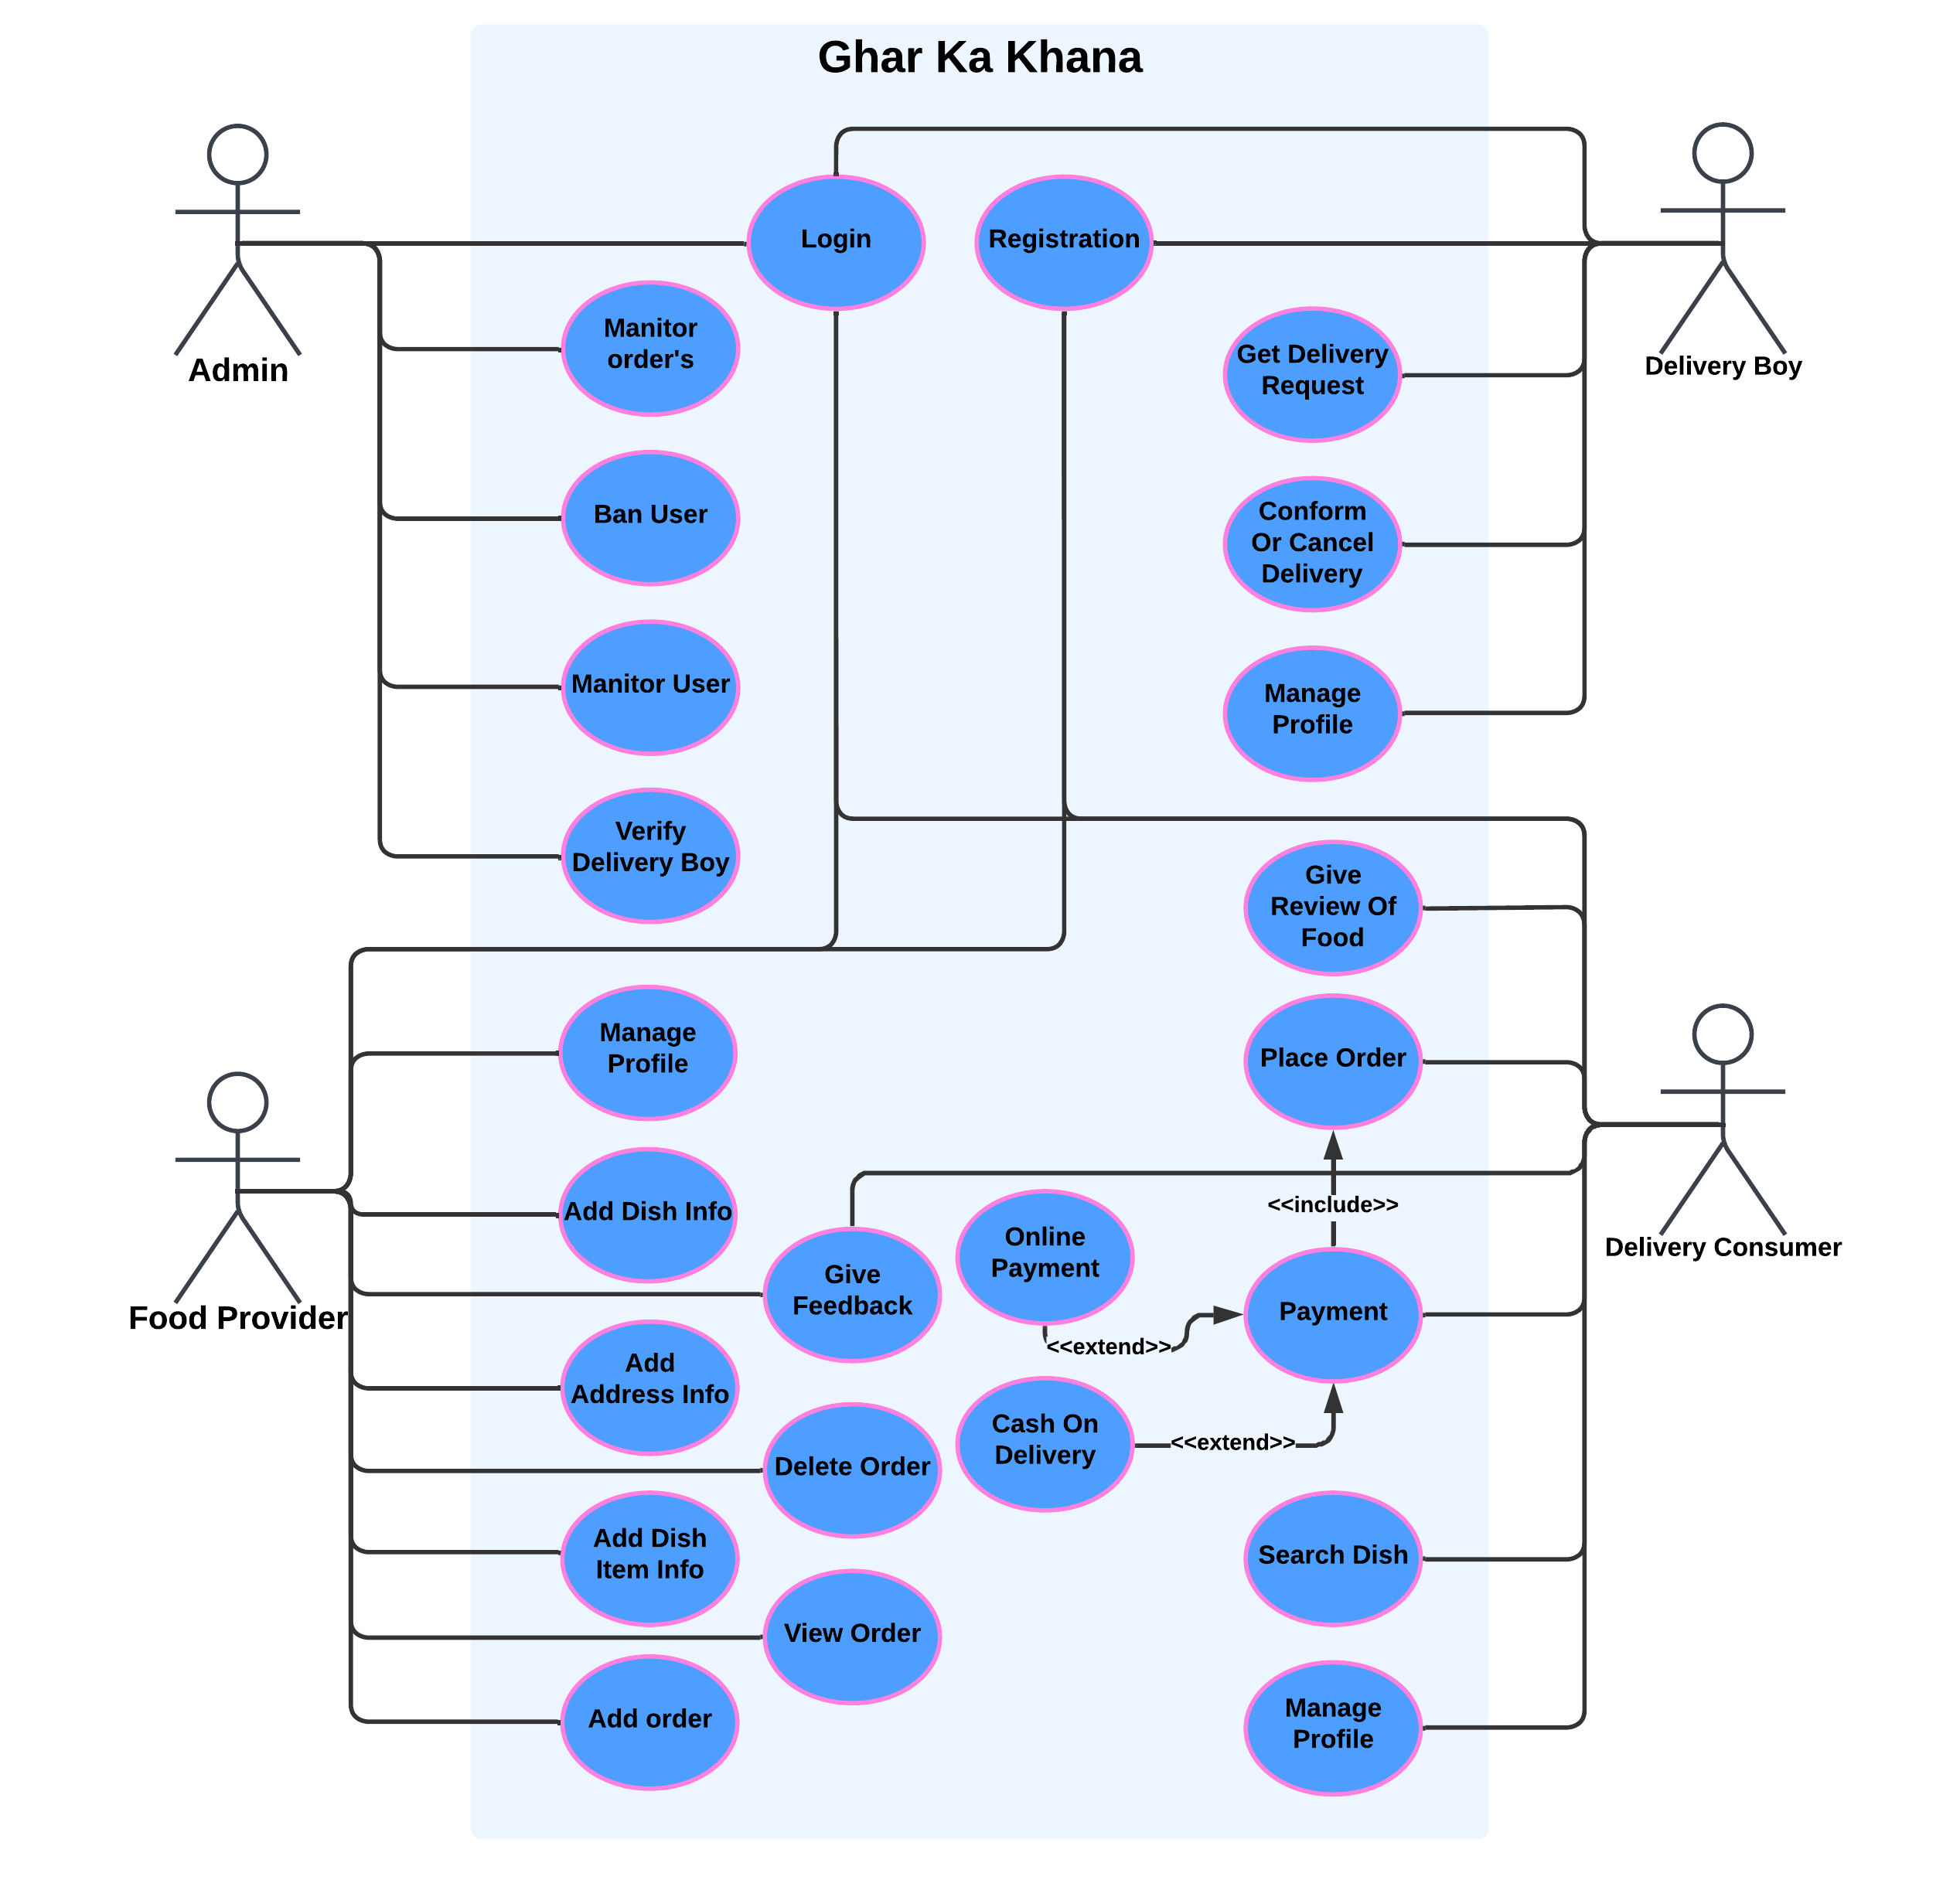
Diagrams: Use-Case

Slide 21
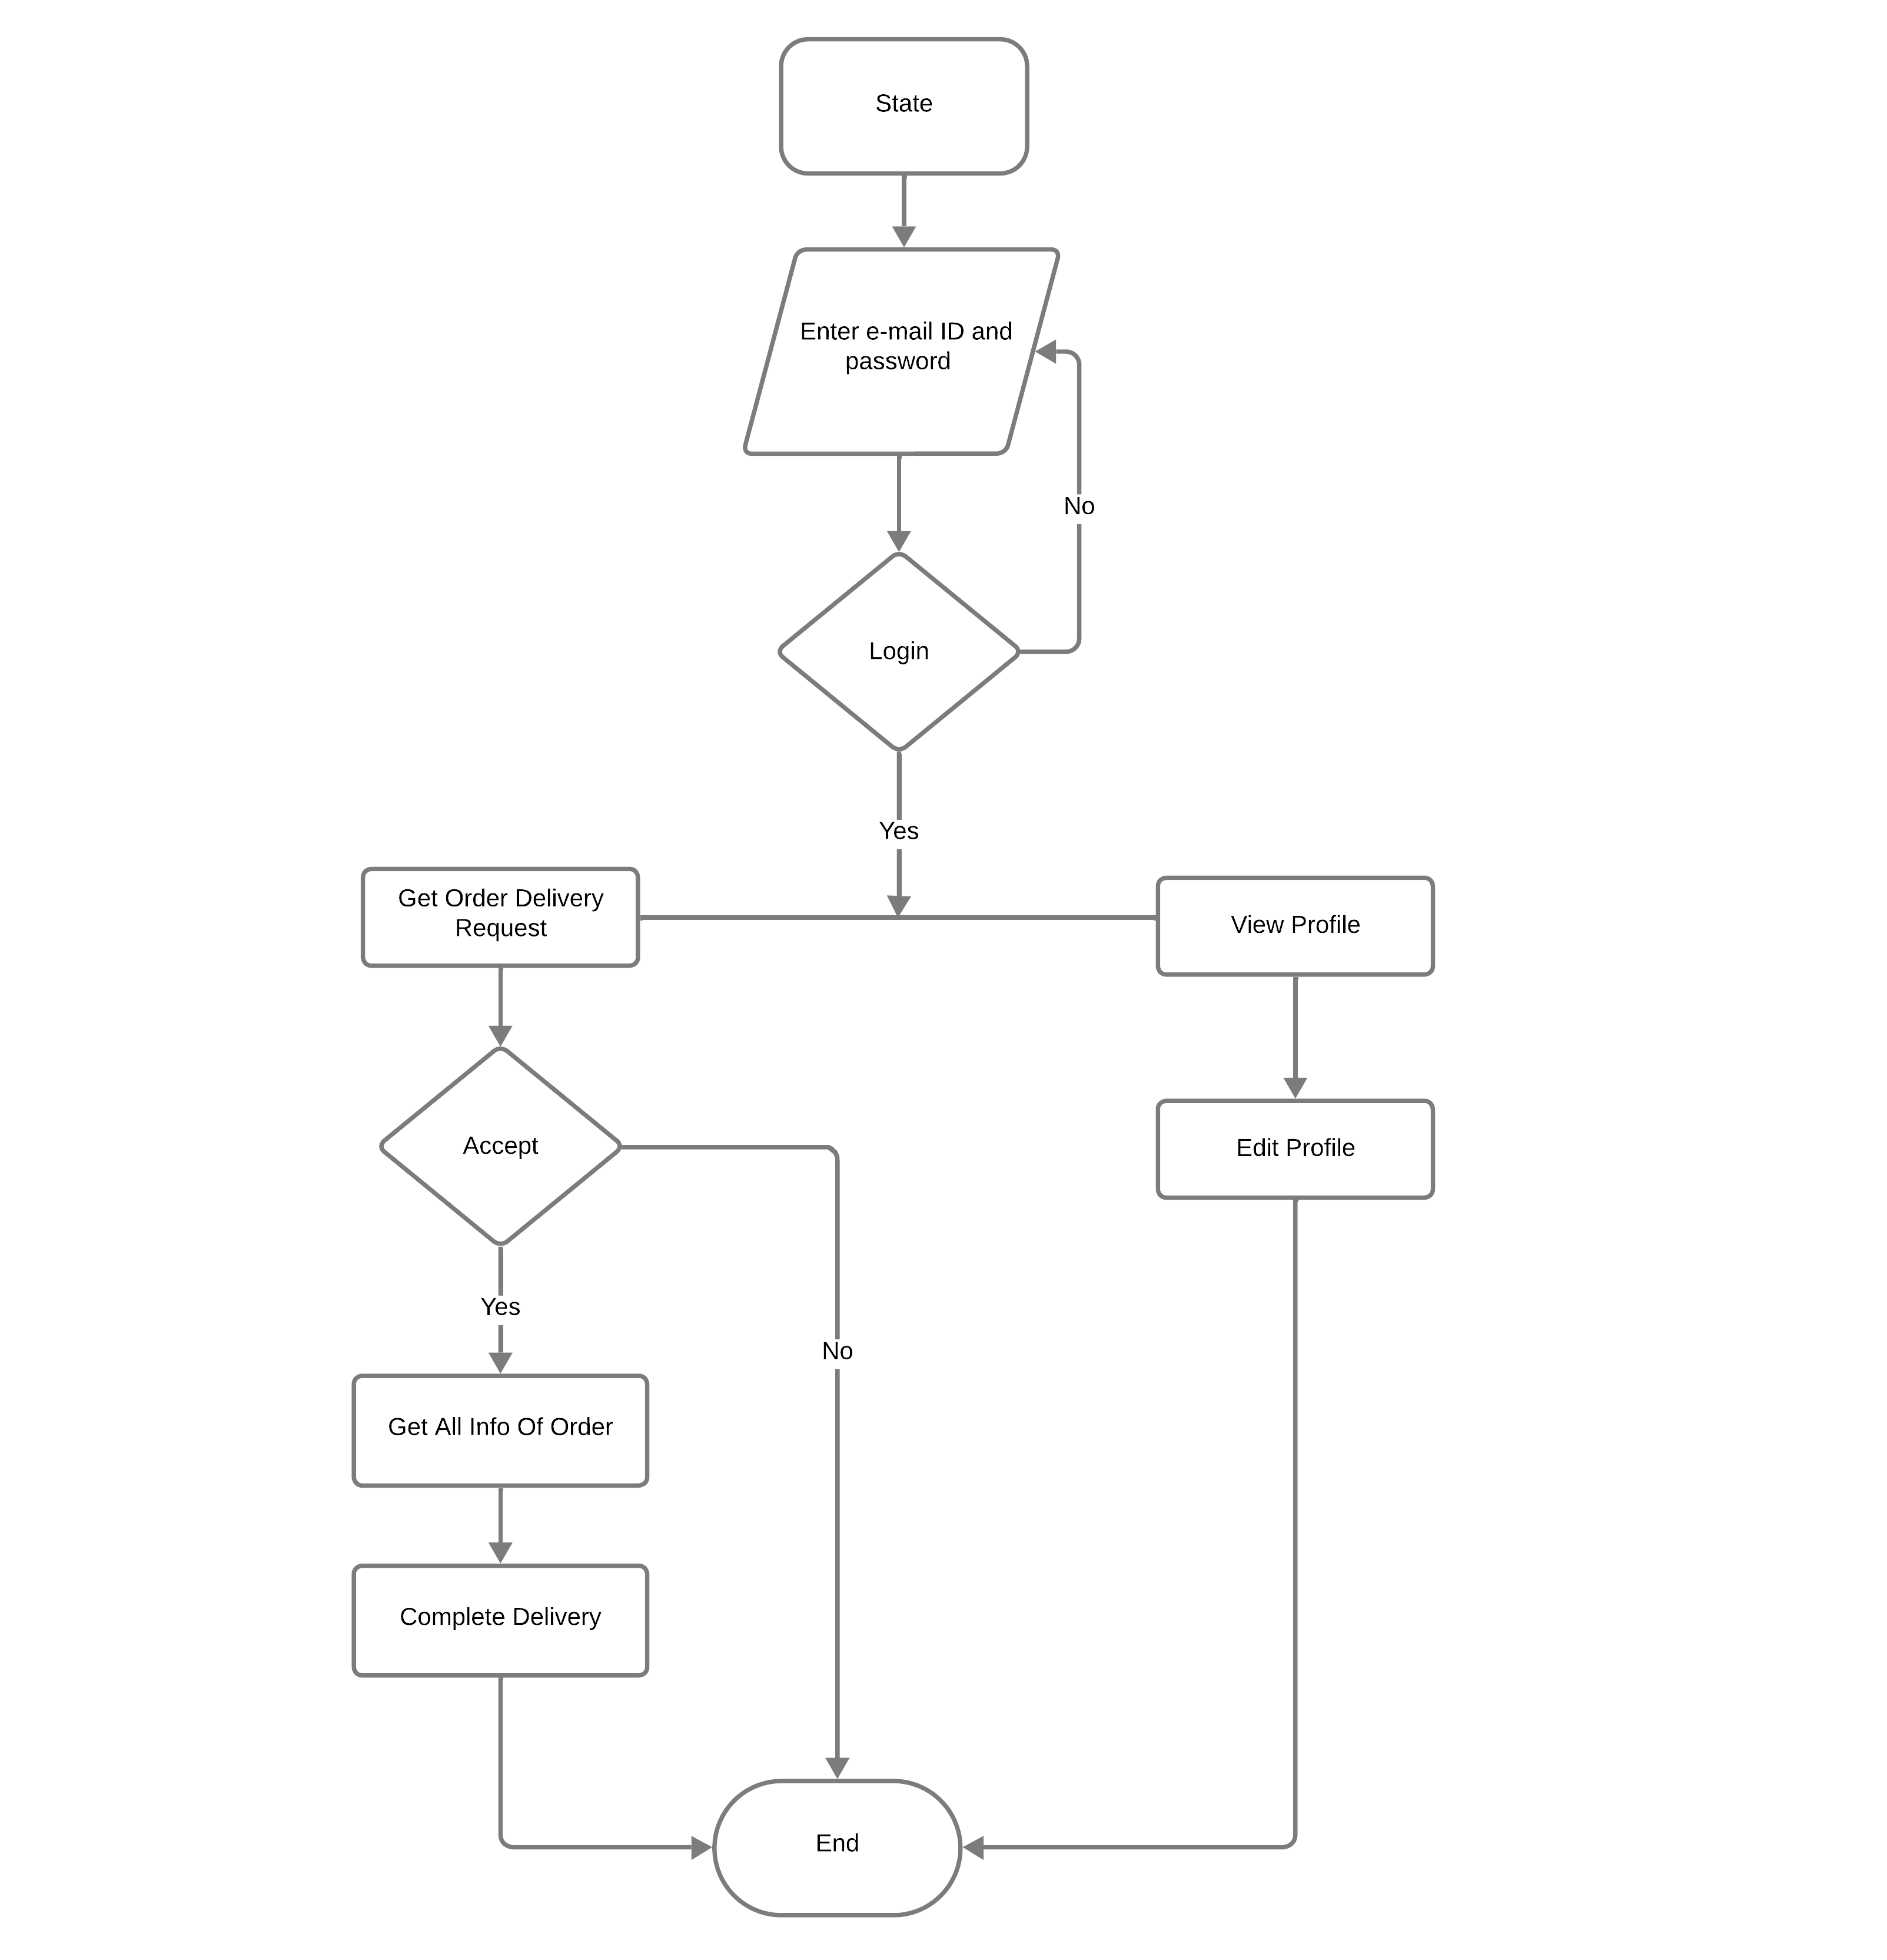
Flow Chart : Delivery Boy

Slide 22
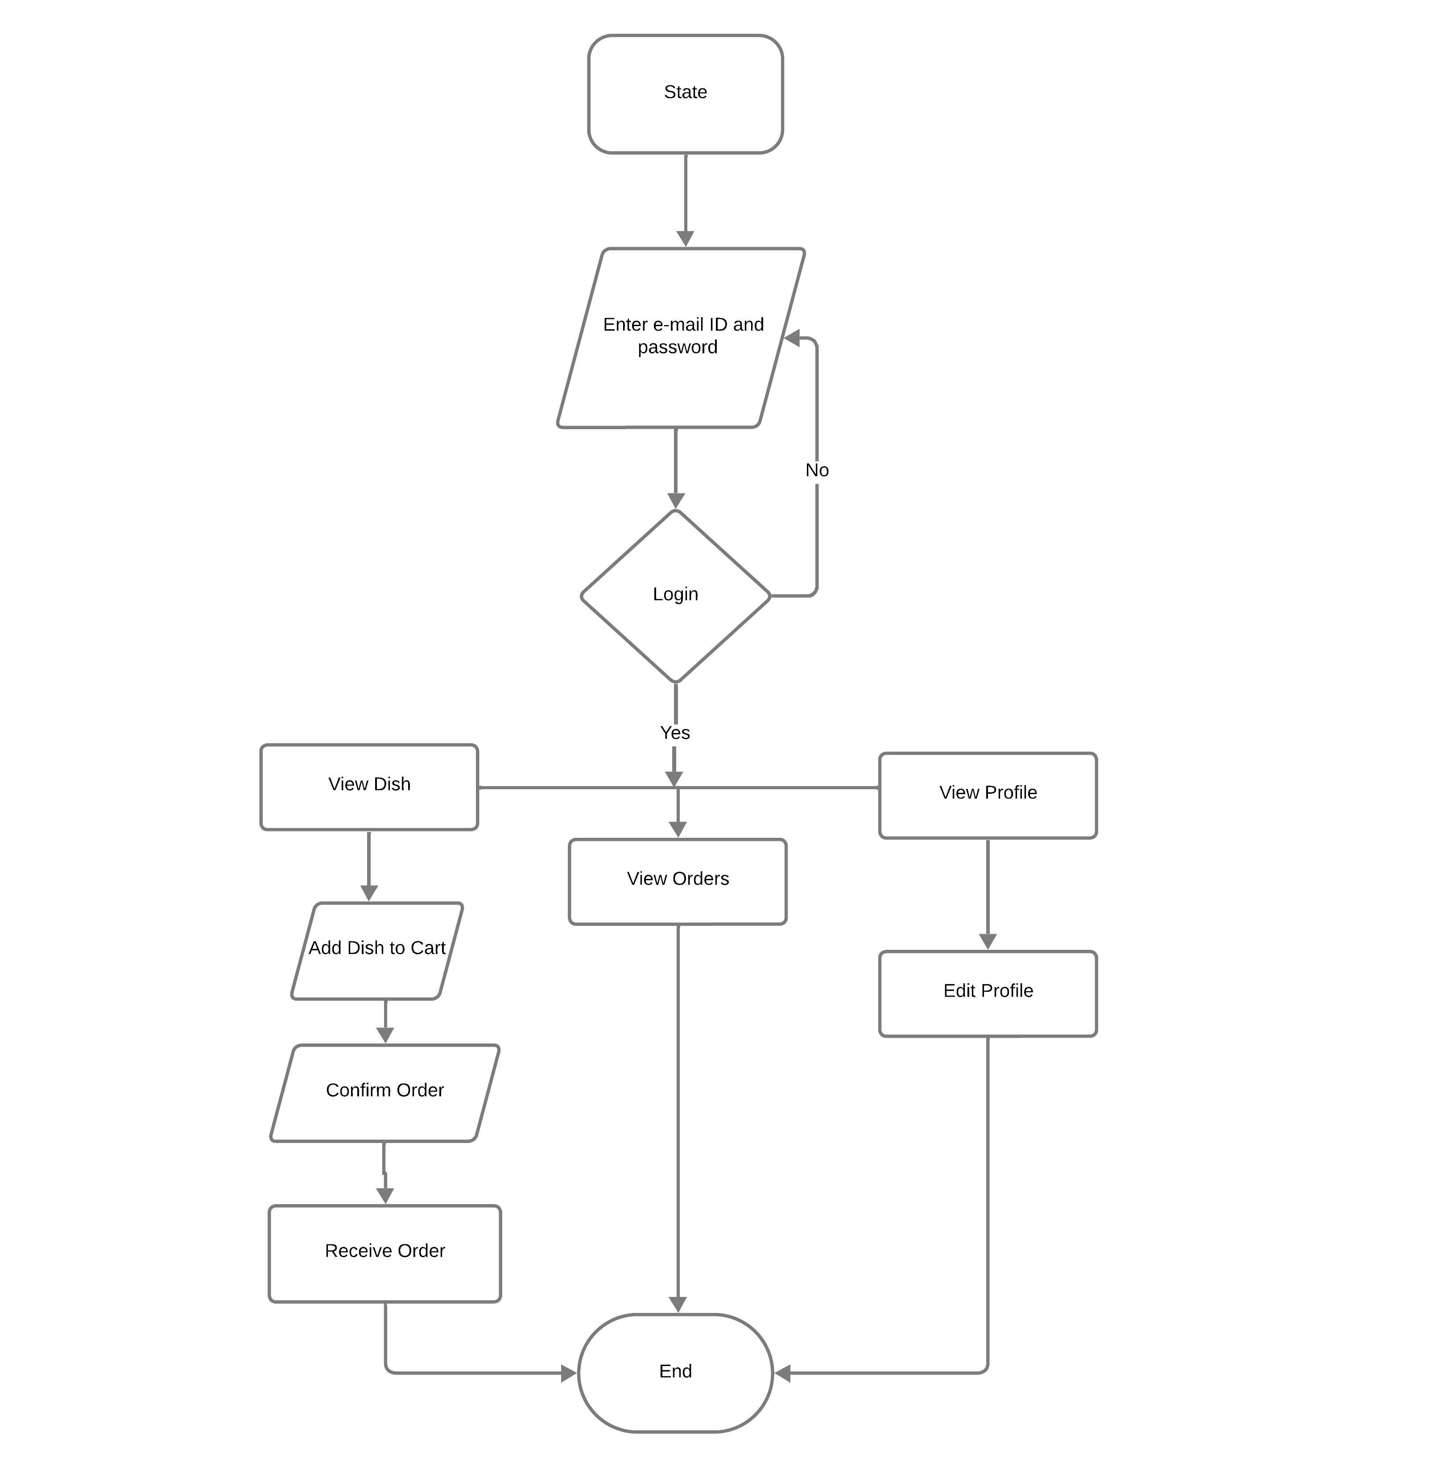
Flow Chart : Food Consumer

Slide 23
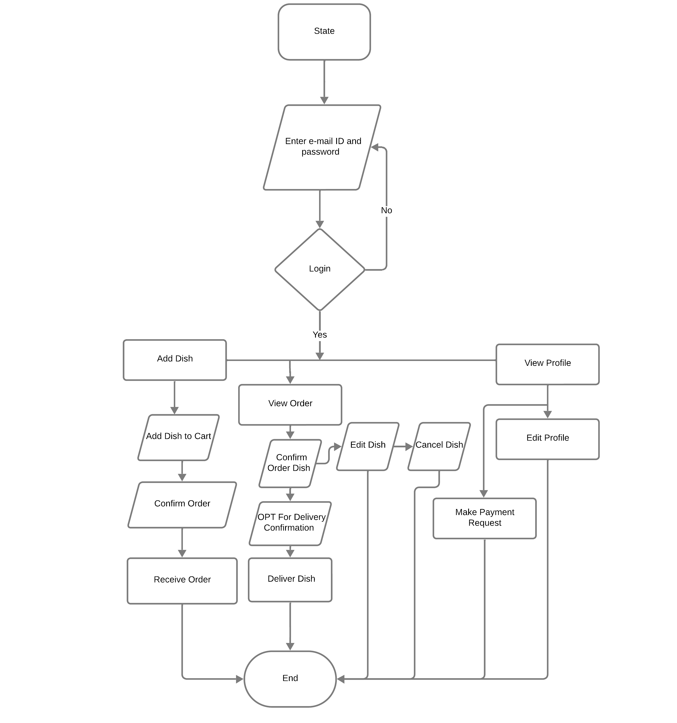
Flow Chart : Food Provider

Slide 24
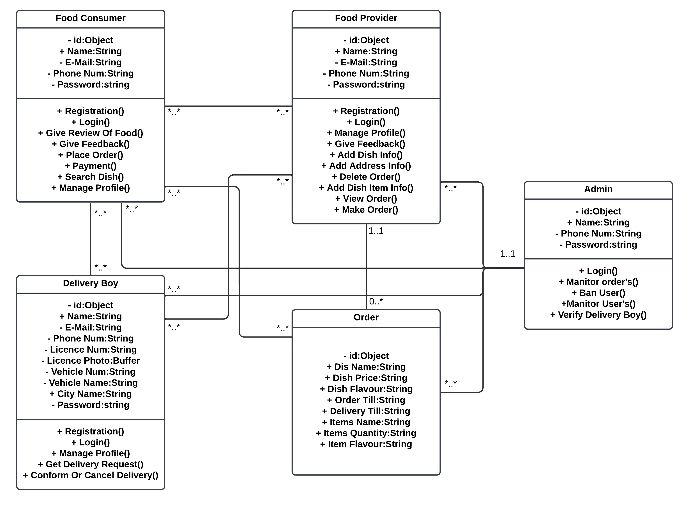
Class Diagram

Slide 25
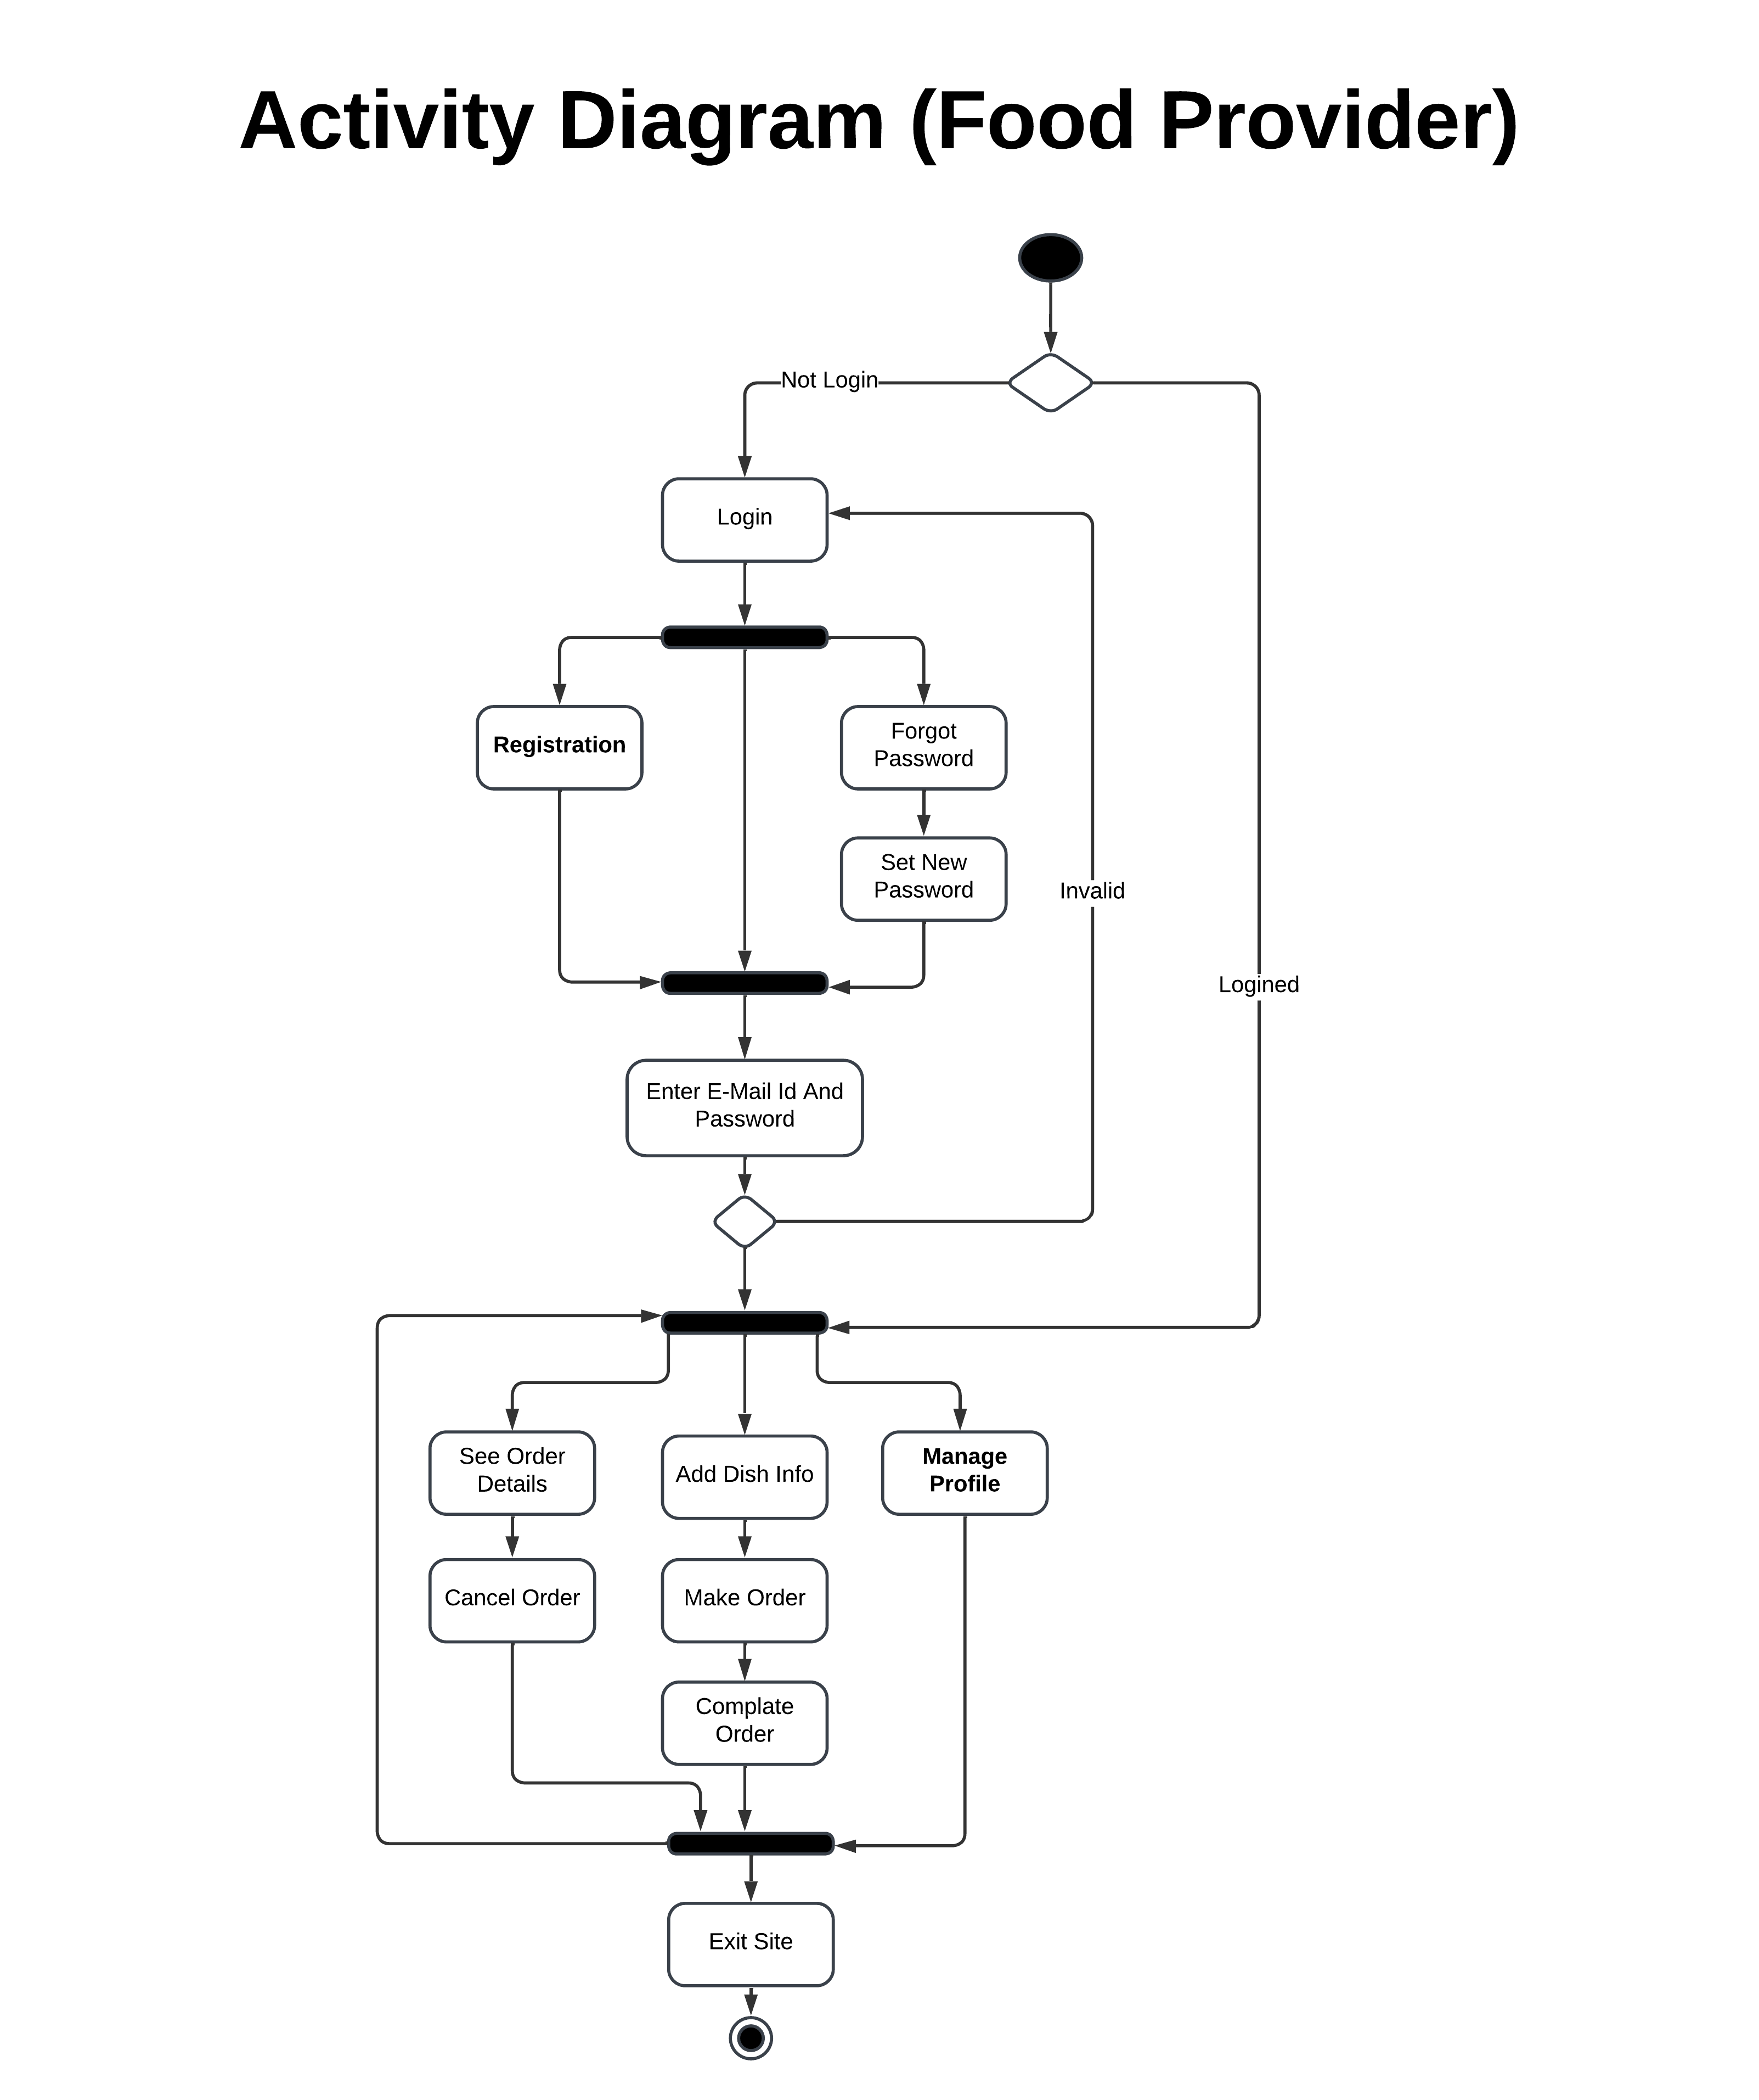
Activity Diagram: Food Provider

Slide 26
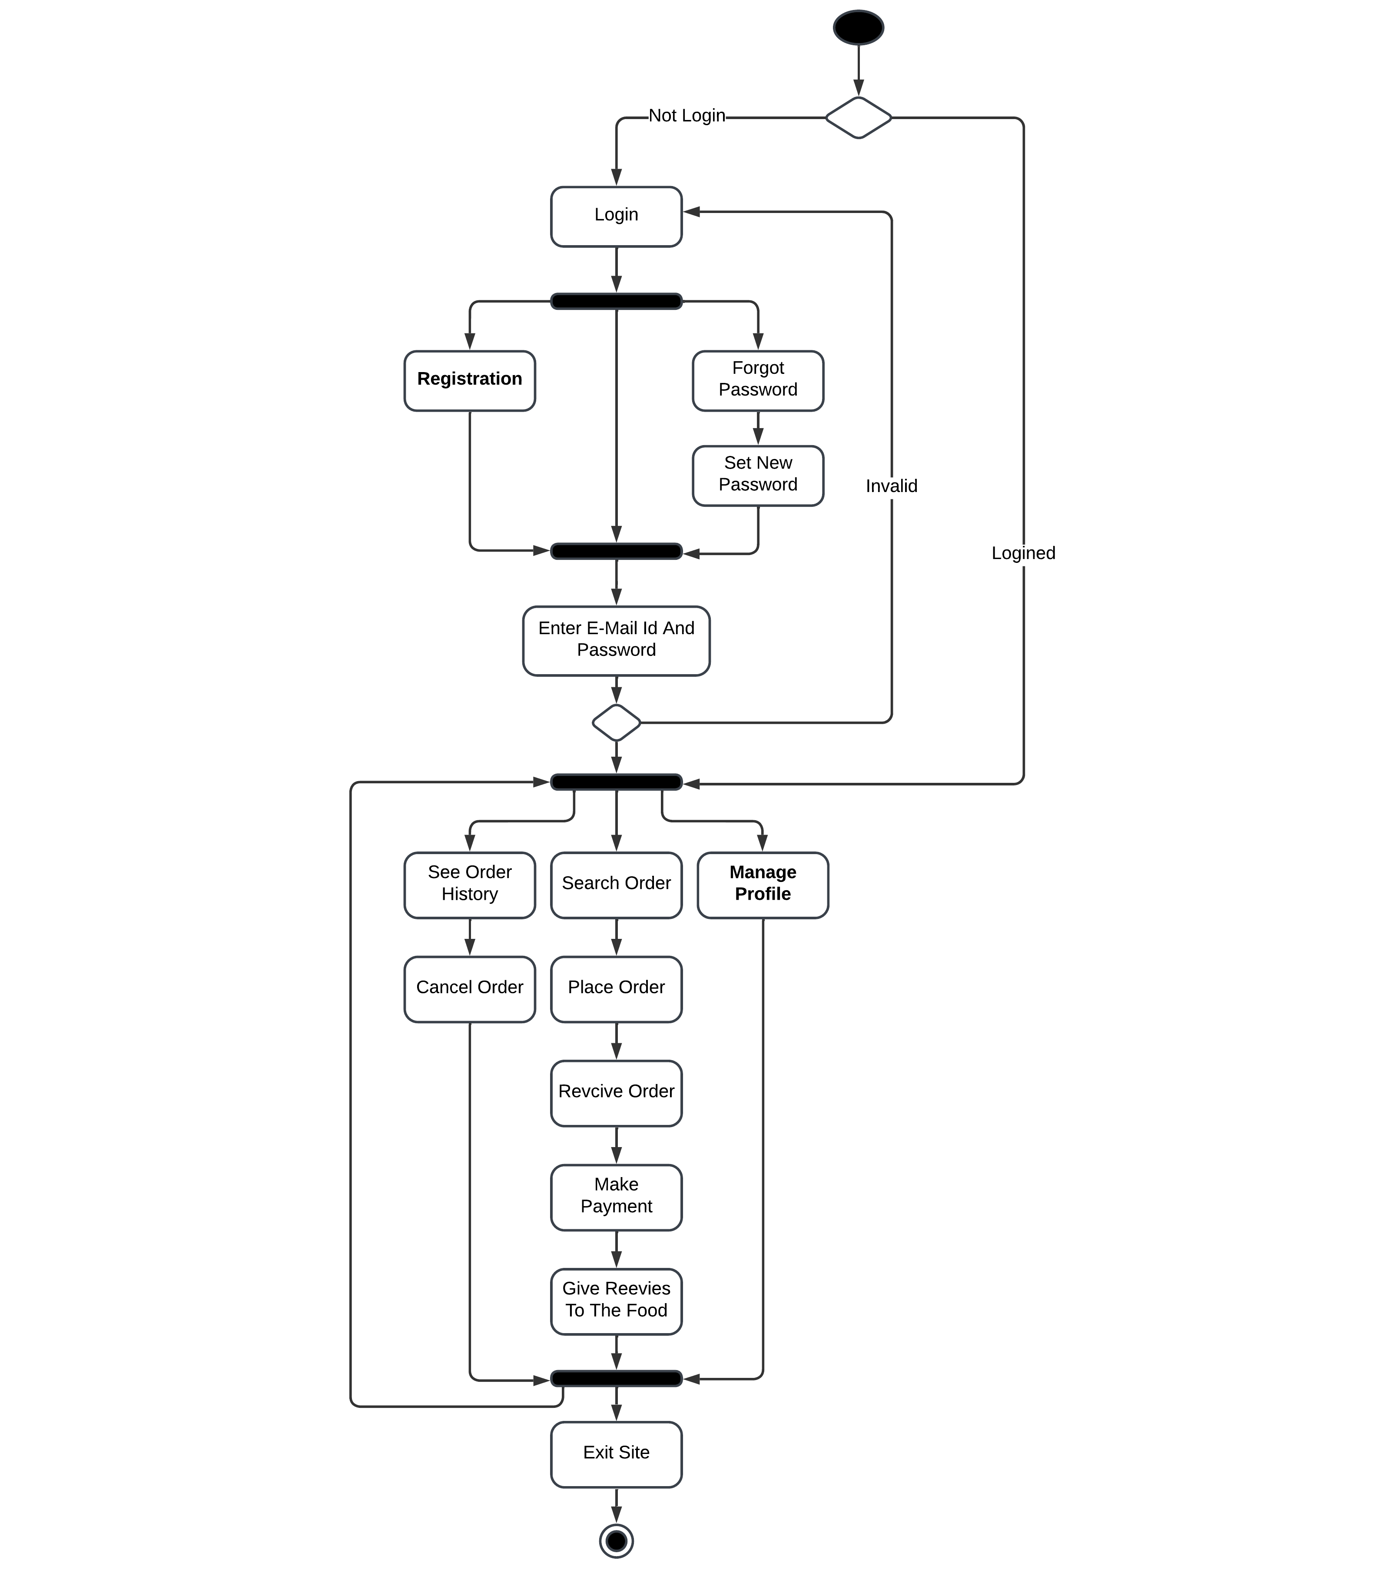
Activity Diagram : Food Consumer

Slide 27
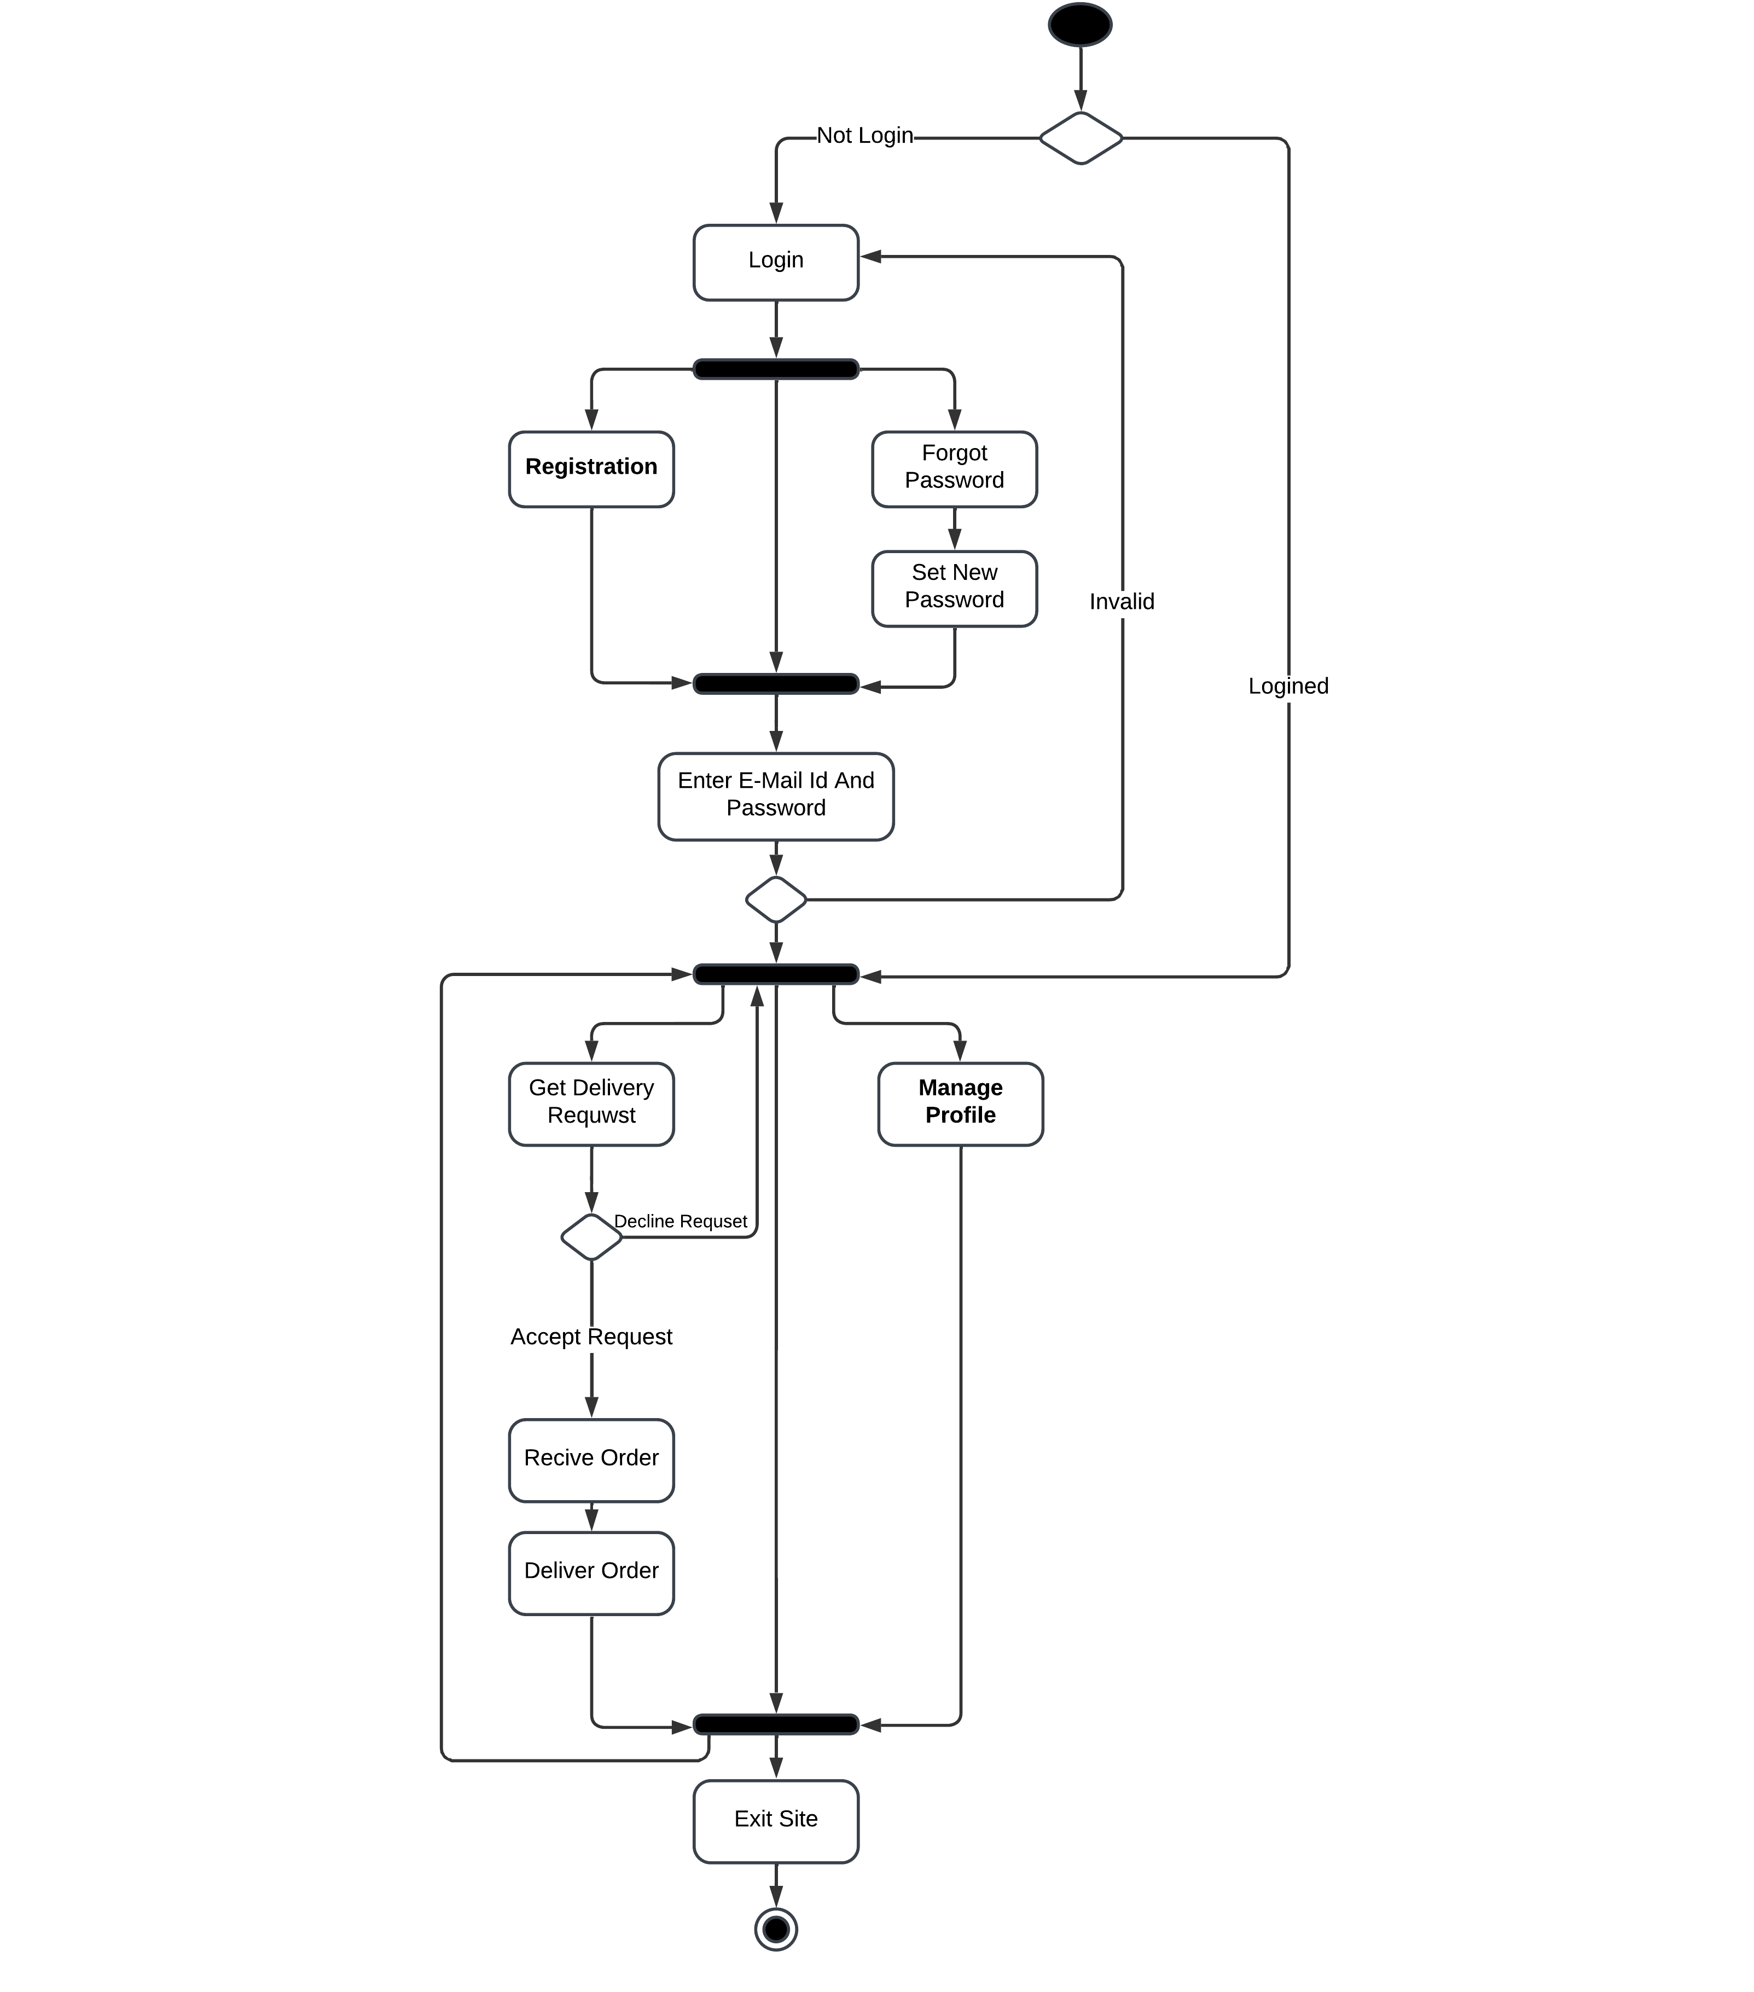
Activity Diagram : Delivery Boy

Slide 28
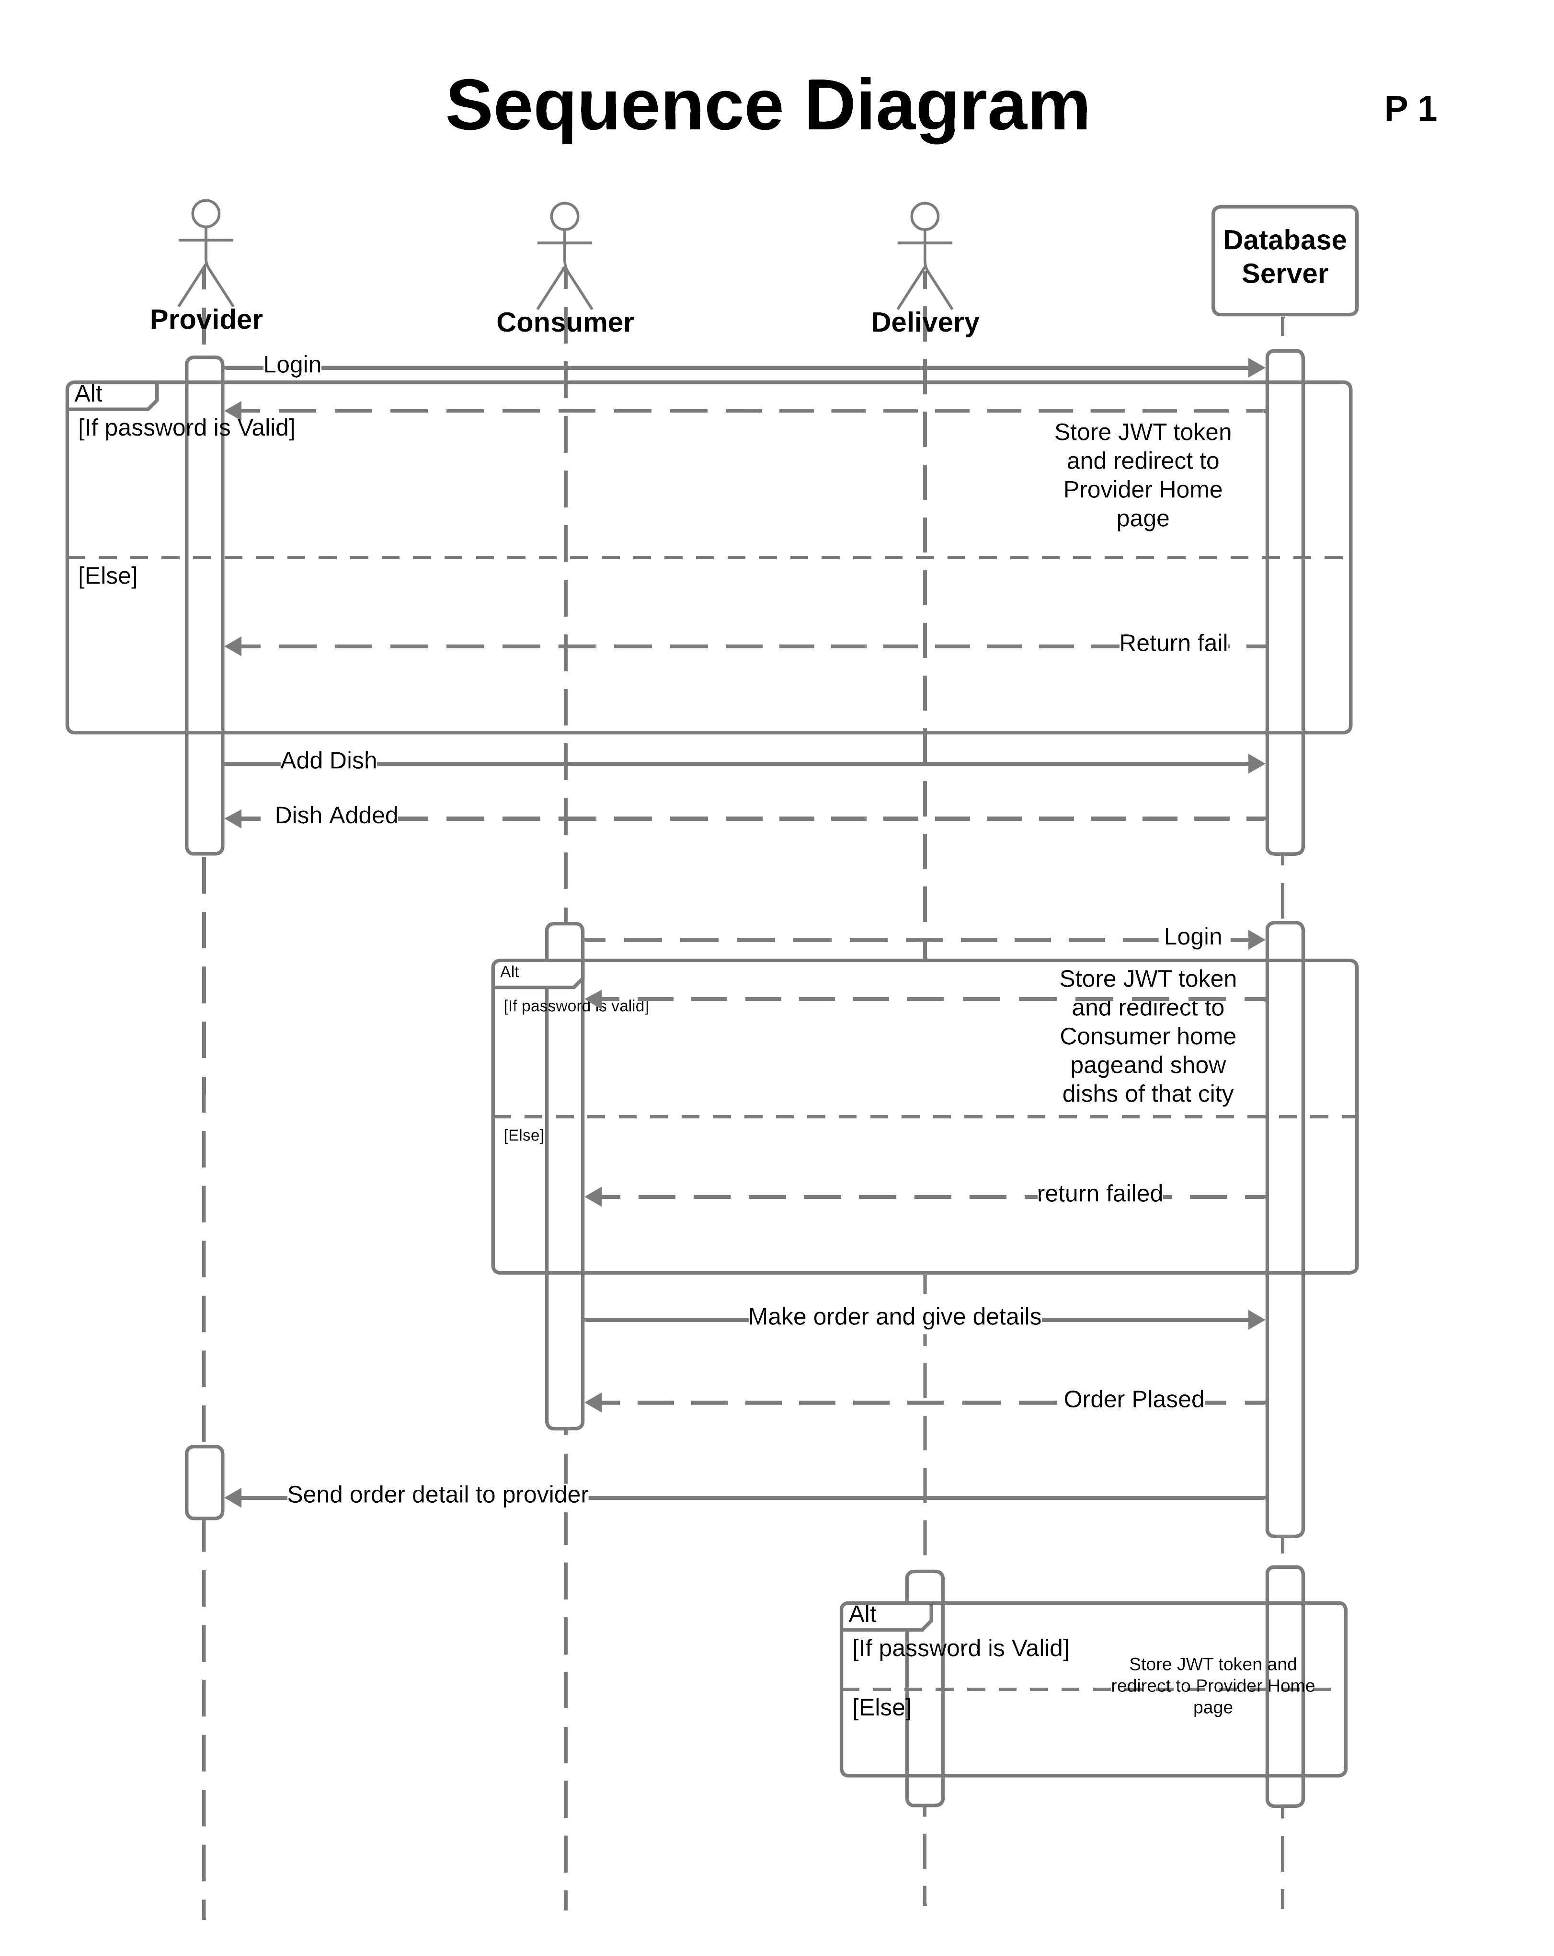
Sequence Diagram P1

Slide 29
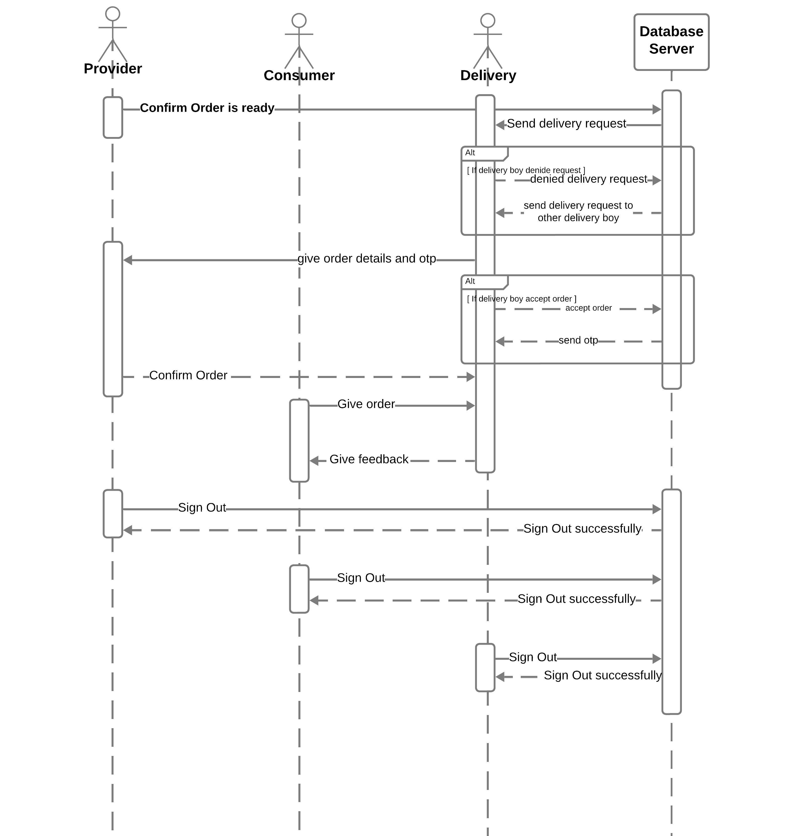
Sequence Diagram P2

Slide 30
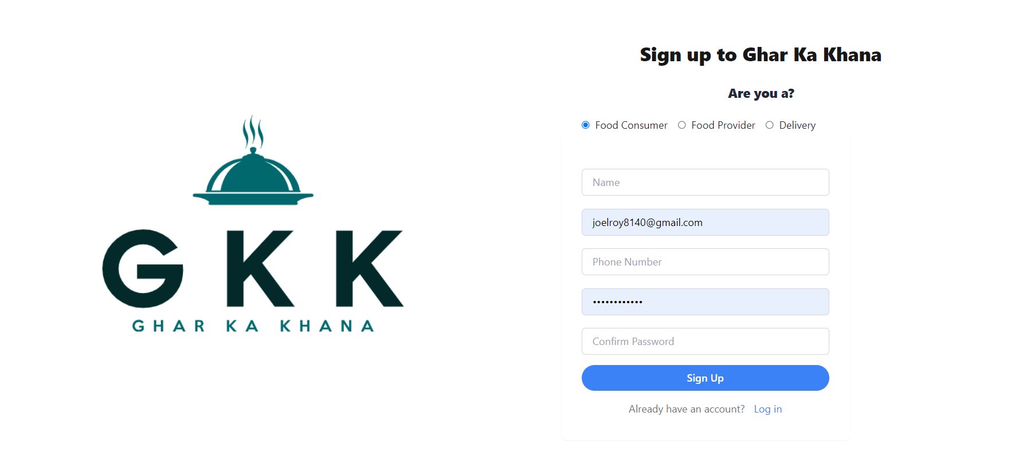
Prototype ( Sign up)

Slide 31
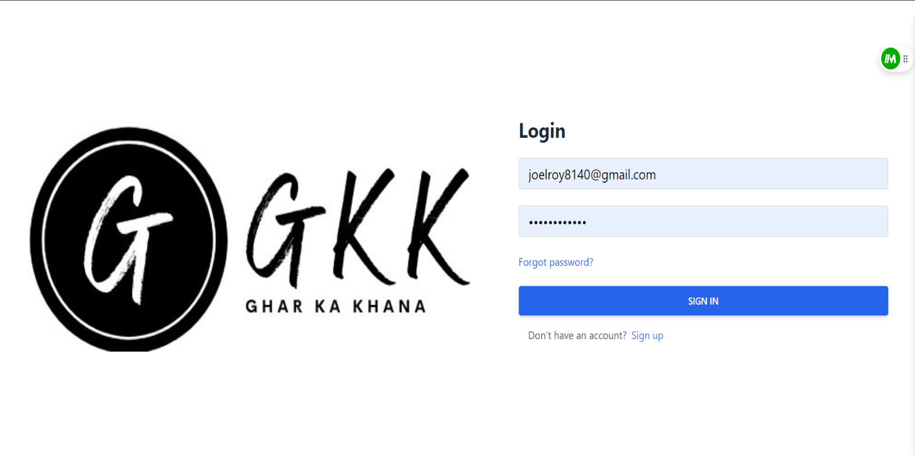
Prototype ( Sign in Page)

Slide 32
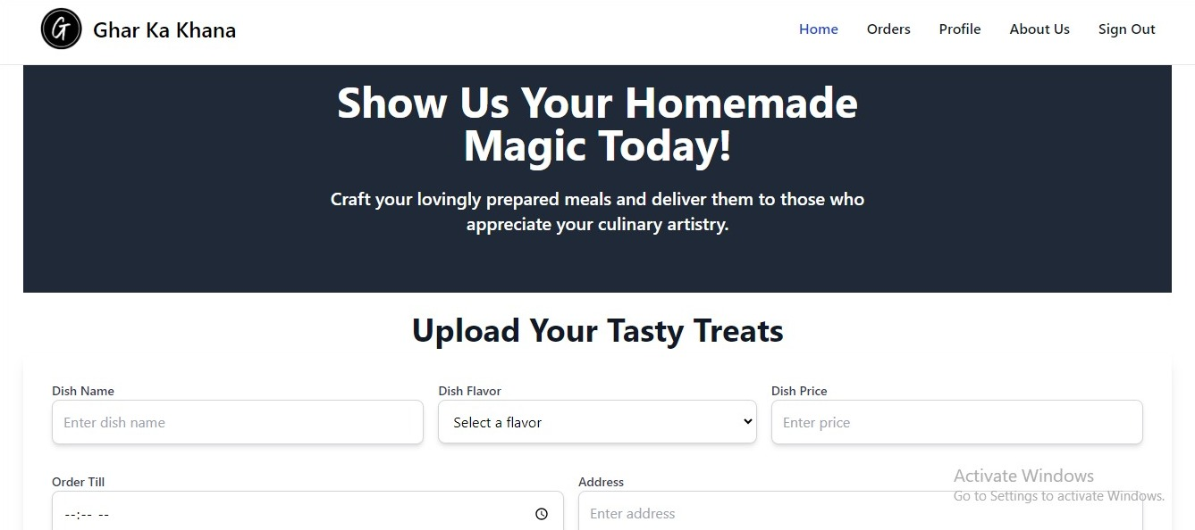
Prototype (Provider Page)

Slide 33
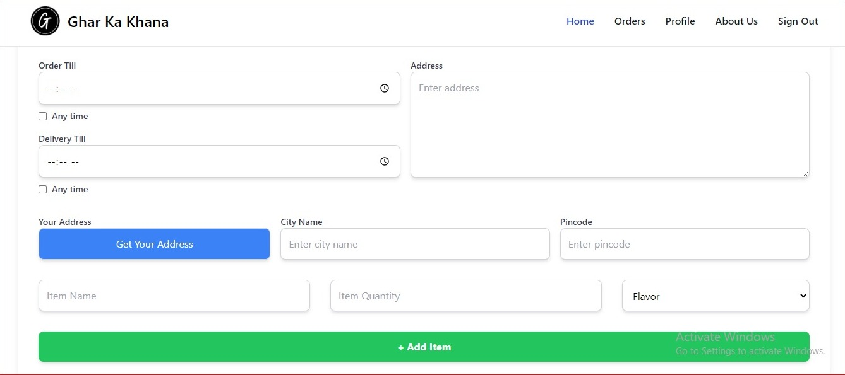
Prototype (Provider Home Page - 2)

Slide 34
Prototype (Delivery Home Page)

Slide 35
Prototype (Provider order page)

Slide 36
Prototype (Provider confirm order page)

Slide 37
Prototype (Admin login page)

Slide 38
Prototype (Food provider Dashboard)

Slide 39
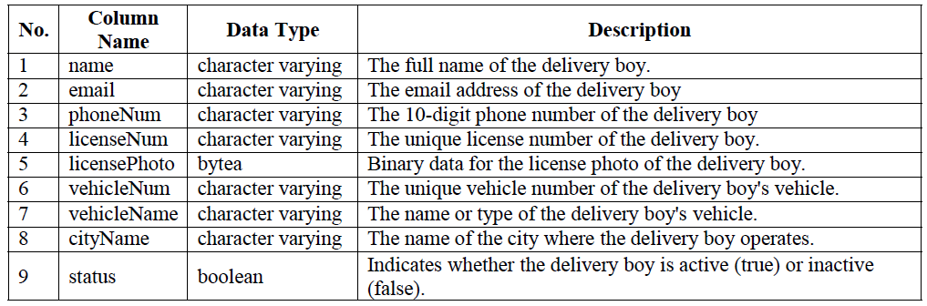
Database Design
Table: DeliveryBoy

Slide 40
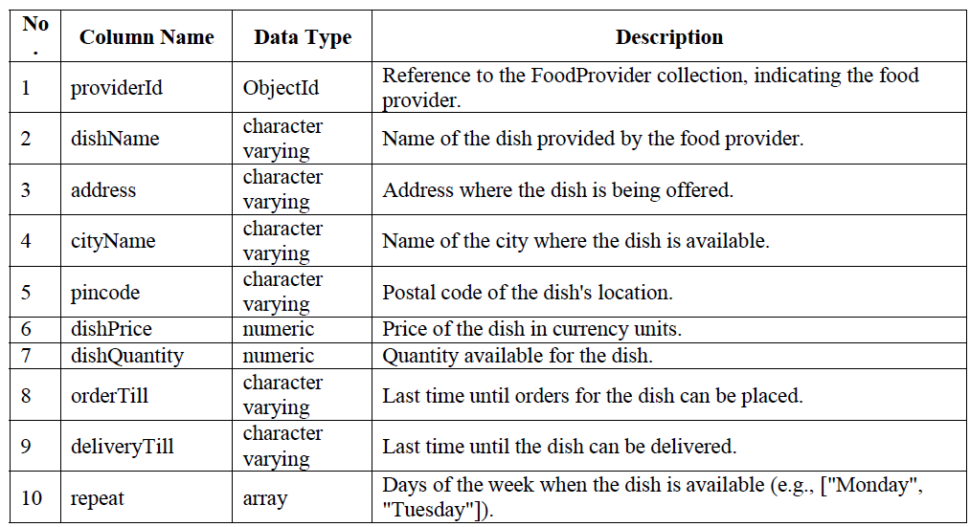
Database Design
Table: DishInfo

Slide 41
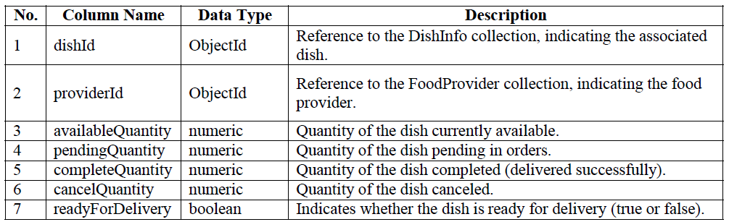
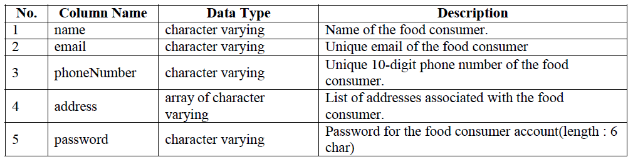
Database Design
Table: Dish Status
Table: FoodConsumer

Slide 42
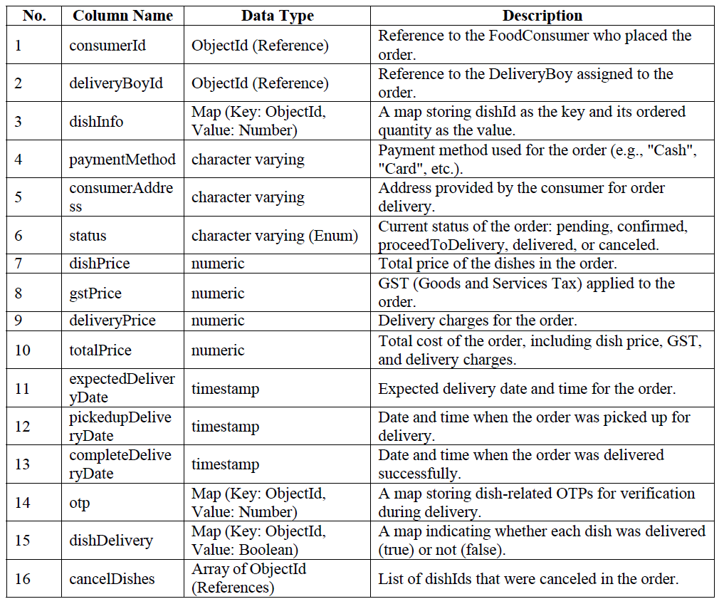
Database Design
Table: OrderInfo

Slide 43
Conclusion
"Ghar ka Khana" successfully addresses the need for healthy, home-cooked meals among students and hostelers.
The platform empowers local mothers by providing an opportunity to showcase and monetize their culinary skills.
It bridges the gap between students/hostelers and local home cooks, offering a convenient and affordable solution for nutritious meals.
The project includes a user-friendly web interface, ensuring easy browsing, ordering, and payment processing for students and hostelers.
A separate interface for mothers allows them to manage their dish listings and orders efficiently.
The platform promotes a sustainable, community-driven ecosystem, benefiting both consumers and food providers.
"Ghar ka Khana" contributes to the financial independence of local mothers, fostering economic empowerment.
The initiative aligns with the growing trend of healthy eating and supports a community-based approach to wholesome dining options.

Slide 44
Future Enhancements
Mobile App Integration: Develop a dedicated mobile application for "Ghar ka Khana," allowing users to browse, order, and track homemade meals seamlessly on their smartphones.
Responsive User Interface: Ensure the platform is fully responsive, adapting smoothly to different screen sizes and devices, improving user experience for mobile and tablet users.
Enhanced Order Tracking System: Implement real-time order tracking for both users and delivery personnel, providing updates on meal preparation, delivery time, and more.
Personalized Meal Suggestions: Introduce a recommendation system that suggests meals to users based on their preferences and previous orders.
Expanded Cook Base: Expand the network of mothers preparing meals, ensuring users have access to a wider variety of homemade food options.
Subscription Plans: Offer meal subscription packages where users can sign up for daily, weekly, or monthly meal plans for a consistent, hassle-free food experience.
Nutritional Information: Provide detailed nutritional information for each meal, allowing users to make informed choices about their food.
Enhanced Payment Options: Integrate additional payment gateways and provide users with more flexibility in making payments, such as digital wallets, UPI, and bank transfers.
Map Integration: Add map integration to show delivery routes, nearby cooks, and estimated arrival times directly on the platform.

Slide 45
References
Zomato: zomato.com
Swiggy: swiggy.com
BigBasket: bigbasket.com
Dunzo: dunzo.com
FoodPanda: foodpanda.com
FreshMenu: freshmenu.com
MasalaBox: masalabox.com
Box8: box8.in
Nosh: nosh.co.in
EazyDiner: eazydiner.com

